Slide 1
Spring AOP

Slide 2
Assessment
What is Spring framework?
How many modules are there in Spring? What are they ?
What is container ?
What are the different types dependency injection ?
What is the difference between Bean Factory and Application Context ?
What are the 3 implementations of the Application Context ?
What are Bean scopes in Spring Framework ?
How do you define Inner Bean? What is the significance of it ?
What is autowiring ? Give one example of it.

Slide 3
Aspect-Oriented Programming
AOP enables modularization of
cross-cutting concerns.
  Cross-cutting concerns: can be defined as the functionality that affects multiple points in the application.
  Separating these cross-cutting concerns from the business logic is where aspect-oriented programming (AOP) goes to work.

Slide 4
What are Crosscutting concerns.
• Generic functionality that is needed in many parts of the application.
Examples
  Logging and Tracing
  Transaction Management
  Security
  Caching
  Performance Monitoring

Slide 5
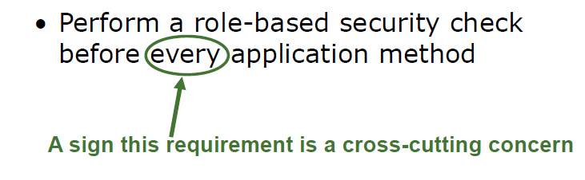
An Example Requirement.

Slide 6
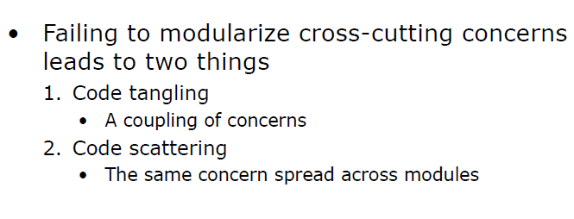
Implementing Cross Cutting Concerns Without Modularization

Slide 7
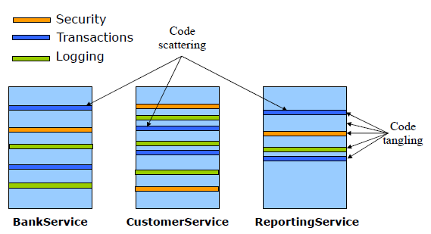
System Evolution without Modularization

Slide 8
Aspect Oriented Programming
AOP enable modularization of cross cutting concerns.
  to avoid tangling
  to eliminate scattering

Slide 9
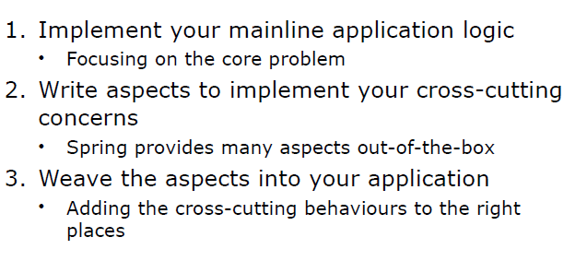
How AOP Works ?

Slide 10
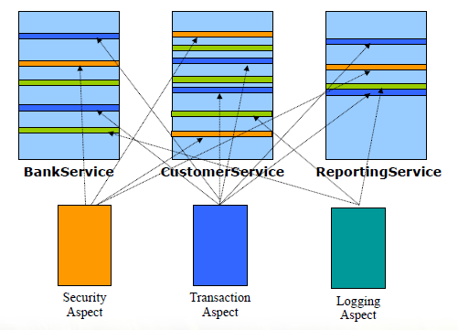
System Evolution : AOP Based

Slide 11
Core AOP Concepts
Aspect: a modularization of a concern that cuts across multiple classes. Transaction management is a good example of a crosscutting concern in J2EE applications. In Spring AOP, aspects are implemented using regular classes (the schema-based approach) or regular classes annotated with the @Aspect annotation (the @AspectJ style).
Advice: action taken by an aspect at a particular join point. Different types of advice include "around," "before" and "after" advice.
Join point: In the application you have thousand of opportunities where the advice can be applied. A joint point is a point in the execution of the application where an aspect can be plugges in.

Slide 12
Core AOP Concepts
Pointcut: a predicate that matches join points , means matches one or more jointpoints where advice needs to be woven. Advice is associated with a pointcut expression and runs at any join point matched by the pointcut .
Target object: object being advised by one or more aspects. Also referred to as the advised object. Since Spring AOP is implemented using runtime proxies, this object will always be a proxied object.
AOP proxy: an object created by the AOP framework in order to implement the aspect contracts (advise method executions and so on). In the Spring Framework, an AOP proxy will be a JDK dynamic proxy or a CGLIB proxy.
Weaving: linking aspects with other application types or objects to create an advised object. Spring AOP, like other pure Java AOP frameworks, performs weaving at runtime.

Slide 13
Types of Advices
Before advice: Advice that executes before a join point, but which does not have the ability to prevent execution flow proceeding to the join point (unless it throws an exception).
After returning advice: Advice to be executed after a join point completes normally: for example, if a method returns without throwing an exception.
After throwing advice: Advice to be executed if a method exits by throwing an exception.

Slide 14
Types of Advices
Around advice: Advice that surrounds a join point such as a method invocation. This is the most powerful kind of advice.
Around advice can perform custom behavior before and after the method invocation.
It is also responsible for choosing whether to proceed to the join point or to shortcut the advised method execution by returning its own return value or throwing an exception.

Slide 15
AOP Proxies
Spring AOP defaults to using standard J2SE dynamic proxies for AOP proxies. This enables any interface (or set of interfaces) to be proxied.
Spring AOP can also use CGLIB proxies. This is necessary to proxy classes, rather than interfaces. CGLIB is used by default if a business object does not implement an interface. As it is good practice to program to interfaces rather than classes, business classes normally will implement one or more business interfaces.

Slide 16
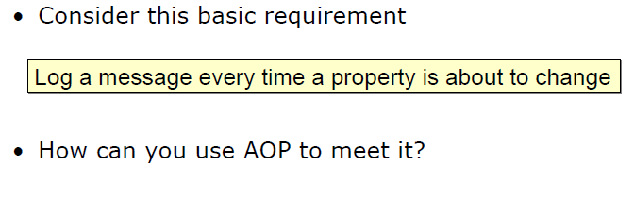
AOP Quick Start

Slide 17
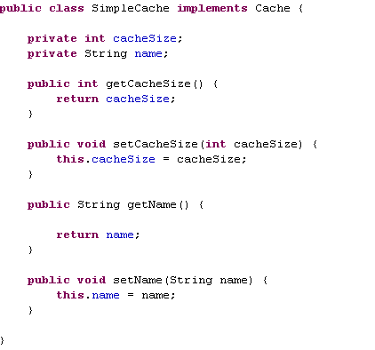
An Application Object whose properties can change

Slide 18
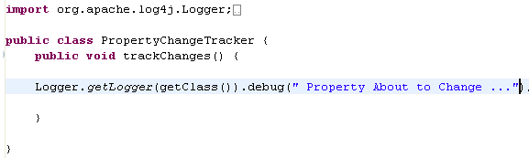
Implement the Aspect

Slide 19
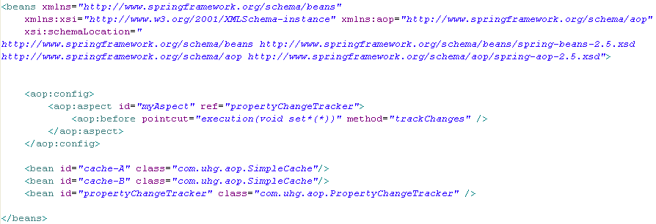
Configuring the Aspect as a Bean

Slide 20
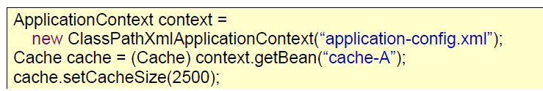
Test the Application

Slide 21
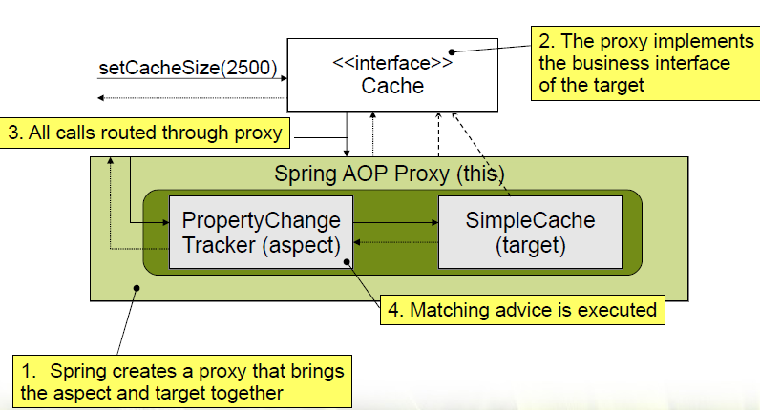
How Aspects are Applied

Slide 22
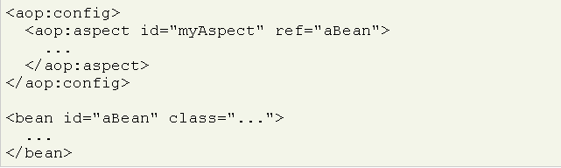
Declaring Aspect
An aspect is declared using the <aop:aspect> element, and the backing bean is referenced using the ref attribute:

Slide 23
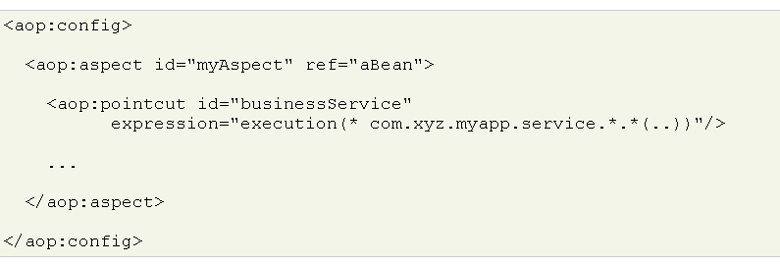
Declaring a Pointcut
A pointcut can be declared inside an <aop:config> element, enabling the pointcut definition to be shared across several aspects and advisors.
A pointcut representing the execution of any business service in the service layer could be defined as follows:

Slide 24
Defining Pointcuts
With Spring AOP you write pointcuts using AspectJ’s pointcut expression language.
Common Pointcut Designator
execution(<method pattern>)
  This method must match the pattern
Can chain together to create complex pointcuts
  &&(and) , || (or) , ! (not)
Method Pattern
  [Modifiers] ReturnType [ClassType] MethodName([Aruments])

Slide 25
Defining Pointcuts
With Spring AOP you write pointcuts using AspectJ’s pointcut expression language.
Common Pointcut Designator
execution(<method pattern>)
  This method must match the pattern
Can chain together to create complex pointcuts
  &&(and) , || (or) , ! (not)
Method Pattern
  [Modifiers] ReturnType [ClassType] MethodName([Aruments])

Slide 26
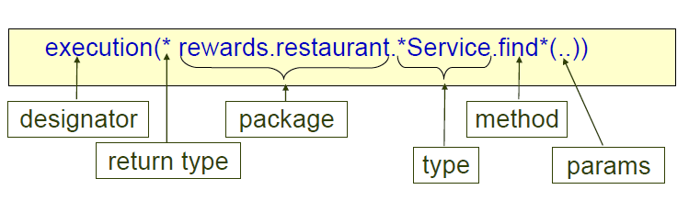
Writing Expression

Slide 27
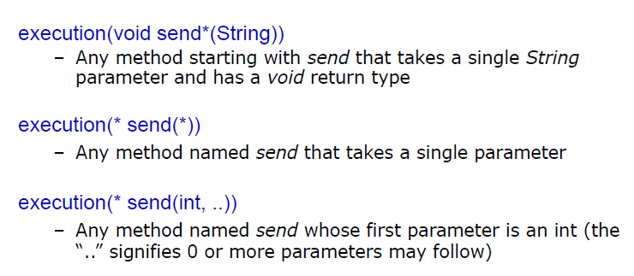
Executing Expression Examples

Slide 28
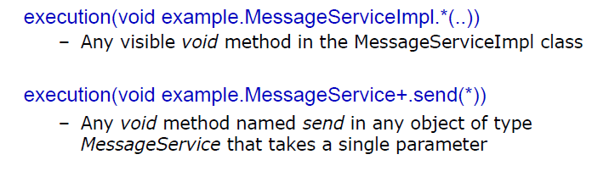
Executing Expression Examples

Slide 29
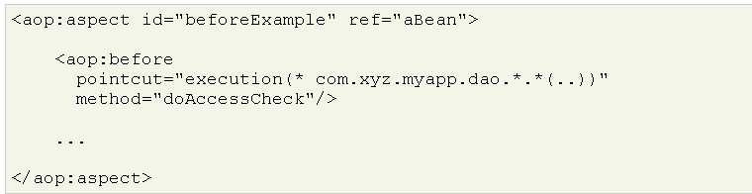
Declaring advice : Before
Before advice runs before a matched method execution. It is declared inside an <aop:aspect> using the <aop:before> element.

Slide 30
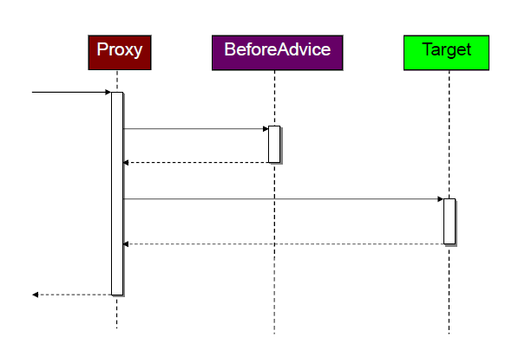
Declaring advice : Before

Slide 31
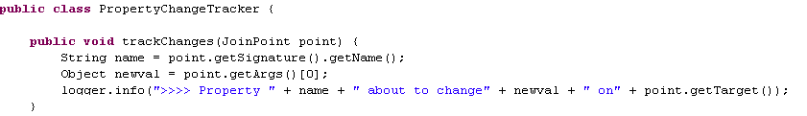
Tracking Property Changes With Context
Context is provided by the JointPoint method paramter

Slide 32
Test the Application

Slide 33
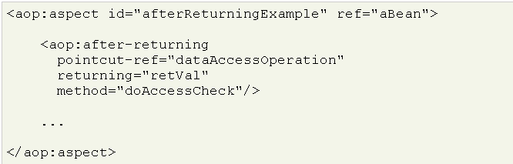
Declaring advice : After
After returning advice runs when a matched method execution completes normally. It is declared inside an <aop:aspect> in the same way as before advice.
The doAccessCheck method must declare a parameter named retVal.

Slide 34
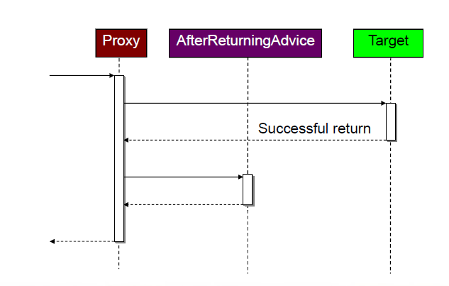
Declaring advice : After

Slide 35
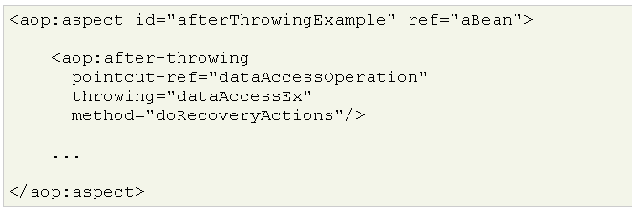
Declaring advice :After throwing
After throwing advice executes when a matched method execution exits by throwing an exception. It is declared inside an <aop:aspect> using the after-throwing element:
Use the throwing attribute to specify the name of the parameter to which the exception should be passed:
the method signature may be declared as:

Slide 36
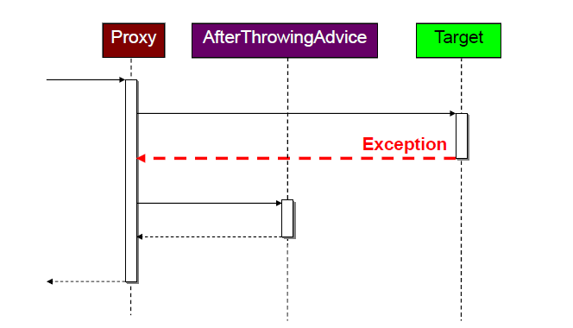
Declaring advice :After throwing

Slide 37
Declaring advice :Around
The final kind of advice is around advice. Around advice runs "around" a matched method execution.
It has the opportunity to do work both before and after the method executes, and to determine when, how, and even if, the method actually gets to execute at all.
Around advice is declared using the aop:around element. The first parameter of the advice method must be of type ProceedingJoinPoint.
Within the body of the advice, calling proceed() on the ProceedingJoinPoint causes the underlying method to execute.
  Inherits from Pointcut and adds the proceed method.

Slide 38
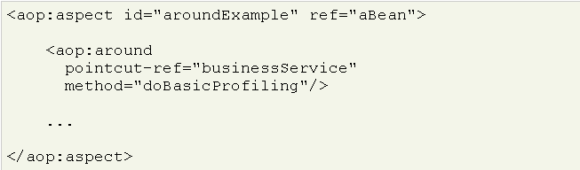
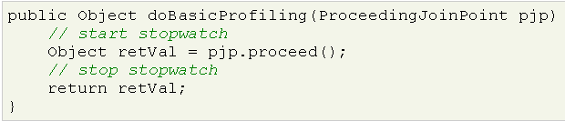
Declaring advice :Around

Slide 39
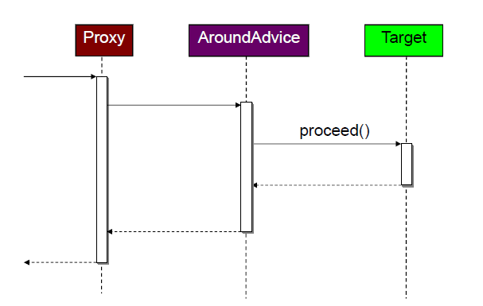
Declaring advice :Around

